Slide 1

Multi Dimensional Arrays

Slide 2
Multi-Dimensional Arrays
Multidimensional Arrays can be defined in simple words as array of arrays.

Slide 3
Multi-Dimensional Arrays
Multidimensional Arrays can be defined in simple words as array of arrays.
Data in multidimensional arrays are stored in tabular form (in row major order).

Slide 4
Multi-Dimensional Arrays
data_type: Type of data to be stored in the array. For example: int, char, etc.

Slide 5
Multi-Dimensional Arrays
data_type: Type of data to be stored in the array. For example: int, char, etc.
dimension: The dimension of the array created. For example: 1D, 2D, etc.

Slide 6
Multi-Dimensional Arrays
data_type: Type of data to be stored in the array. For example: int, char, etc.
dimension: The dimension of the array created. For example: 1D, 2D, etc.
array_name: Name of the array

Slide 7
Multi-Dimensional Arrays
data_type: Type of data to be stored in the array. For example: int, char, etc.
dimension: The dimension of the array created. For example: 1D, 2D, etc.
array_name: Name of the array
size1, size2, …, sizeN: Sizes of the dimensions respectively.

Slide 8
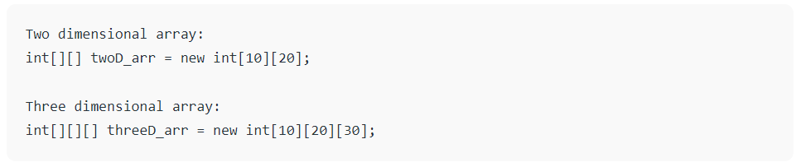
Multi-Dimensional Arrays
Size of multidimensional arrays: The total number of elements that can be stored in a multidimensional array can be calculated by multiplying the size of all the dimensions.

Slide 9
Multi-Dimensional Arrays
For example: The array int[][] x = new int[10][20] can store a total of (10*20) = 200 elements. Similarly, array int[][][] x = new int[5][10][20] can store a total of (5*10*20) = 1000 elements.

Slide 10
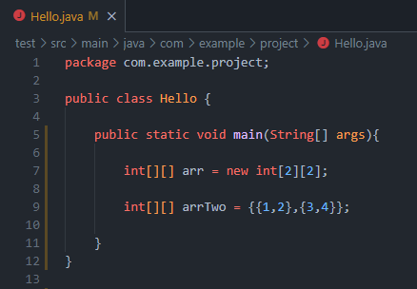
Multi-Dimensional Arrays
A two–dimensional array is the simplest form of a multidimensional array.

Slide 11
Multi-Dimensional Arrays
A two–dimensional array is the simplest form of a multidimensional array.
A two–dimensional array can be seen as an array of a one–dimensional array for easier understanding.

Slide 12
Multi-Dimensional Arrays
A two–dimensional array is the simplest form of a multidimensional array.
A two–dimensional array can be seen as an array of a one–dimensional array for easier understanding.
As with all arrays there are two ways of initializing a two-dimensional array.

Slide 13
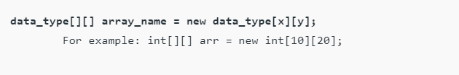
Indirect Method of Declaration
Declaration – Syntax:

Slide 14
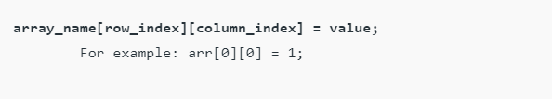
Indirect Method of Declaration
Declaration – Syntax:
Initialization – Syntax:

Slide 15
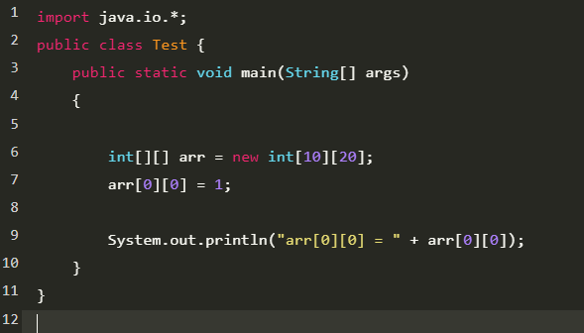
output: arr[0][0] = 1

Slide 16
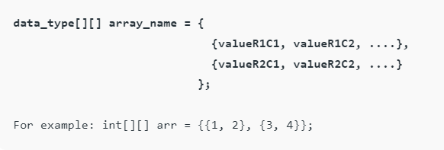
Direct Method of Declaration
Declaration and Initialization:

Slide 17
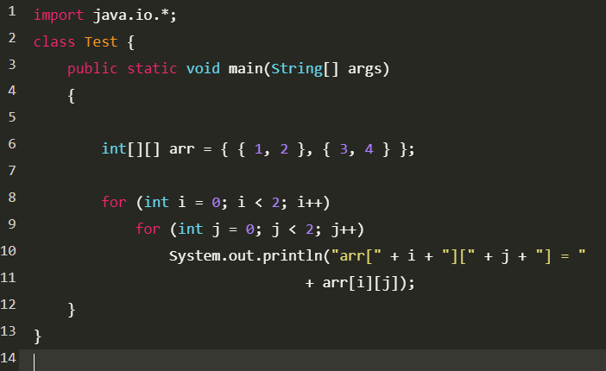
output:
arr[0][0] = 1
arr[0][1] = 2
arr[1][0] = 3
arr[1][1] = 4

Slide 18
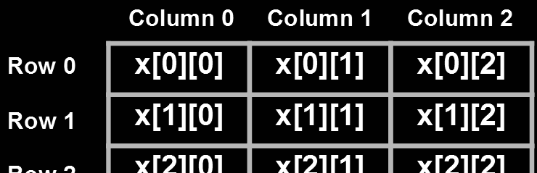
Representing a 2D array in a Tabular Format
A two – dimensional array can be seen as a table with ‘x’ rows and ‘y’ columns where the row number ranges from 0 to (x-1) and column number ranges from 0 to (y-1).
A two – dimensional array ‘x’ with 3 rows and 3 columns is shown below:

Slide 19
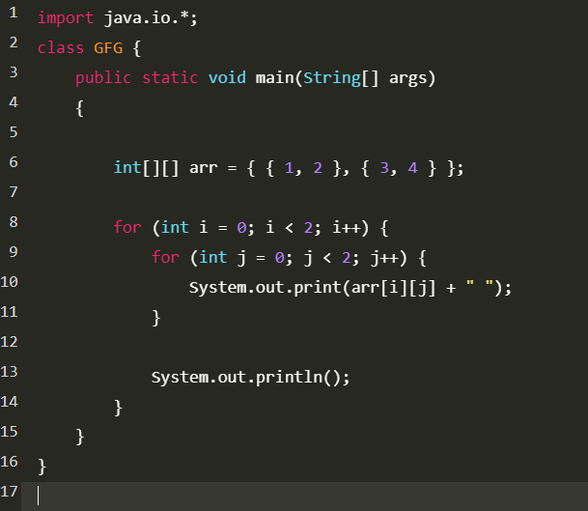
Print 2D array in tabular format
To output all the elements of a Two-Dimensional array, use nested for loops.
Output: 1 2
3 4

Slide 20
Print 2D array in tabular format
To output all the elements of a Two-Dimensional array, use nested for loops.
For this two for loops are required, One to traverse the rows and another to traverse columns.
Output: 1 2
3 4

Slide 21
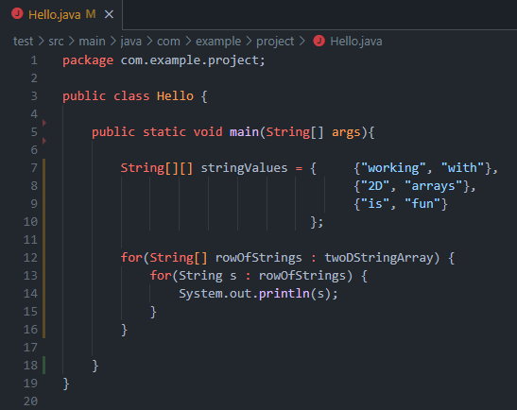
Traversing With Enhanced For Loops
In Java, enhanced for loops can be used to traverse 2D arrays.

Slide 22
Traversing With Enhanced For Loops
In Java, enhanced for loops can be used to traverse 2D arrays.
Because enhanced for loops have no index variable, they are better used in situations where you only care about the values of the 2D array - not the location of those values

Slide 23
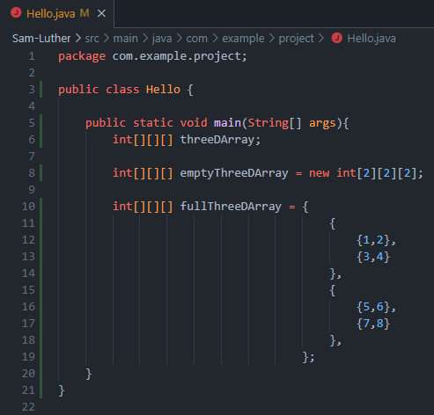
Three – dimensional Array (3D-Array)
A three – dimensional array is a complex form of multidimensional arrays.
A three – dimensional array can be seen as an array of two – dimensional array for easier understanding.
Once again these arrays can be created using two methods.

Slide 24
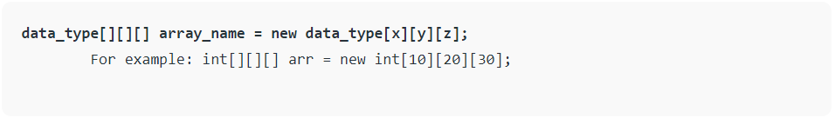
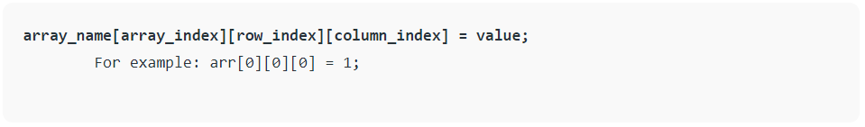
Indirect Method of Declaration
Declaration – Syntax:
Initialization – Syntax:

Slide 25
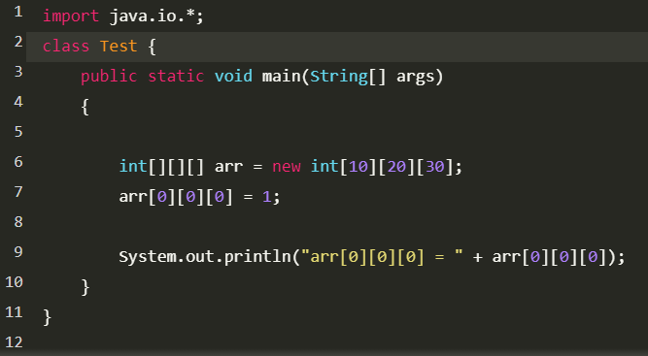
output: arr[0][0][0] = 1

Slide 26
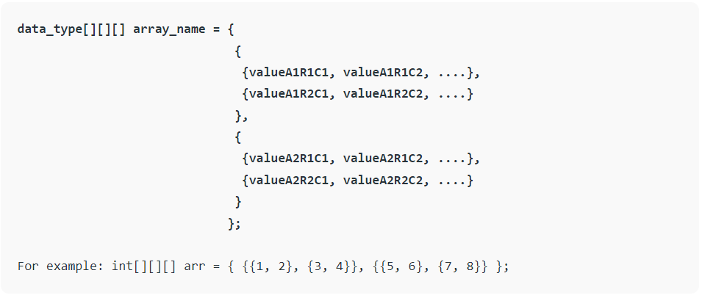
Direct Method of Declaration
Syntax:

Slide 27
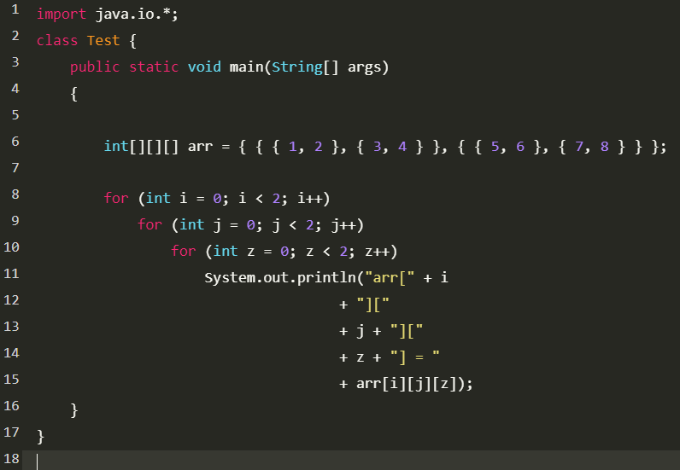
output:
arr[0][0][0] = 1
arr[0][0][1] = 2
arr[0][1][0] = 3
arr[0][1][1] = 4
arr[1][0][0] = 5
arr[1][0][1] = 6
arr[1][1][0] = 7
arr[1][1][1] = 8

Slide 28
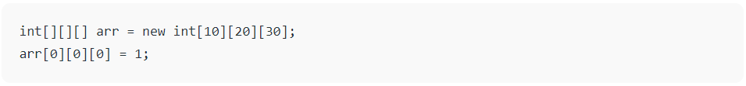
Accessing Elements of Three-Dimensional Arrays
Elements in three-dimensional arrays are commonly referred by x[i][j][k] where ‘i’ is the array number, ‘j’ is the row number and ‘k’ is the column number.
Example:

Slide 29
The above example represents the element present in the first row and first column of the first array in the declared 3D array.
Note: In arrays if size of array is N. Its index will be from 0 to N-1. Therefore, for row_index 2, actual row number is 2+1 = 3.

Slide 30
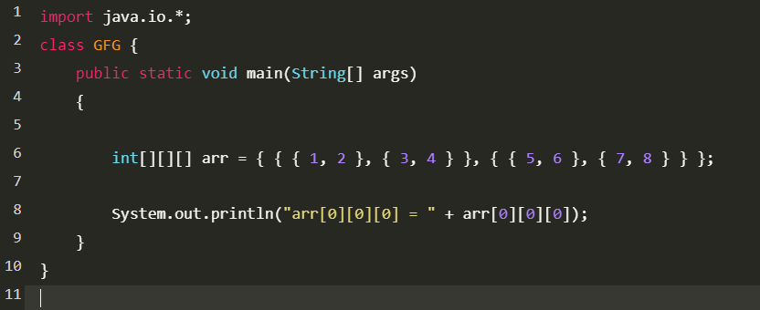
output: arr[0][0][0] = 1

Slide 31
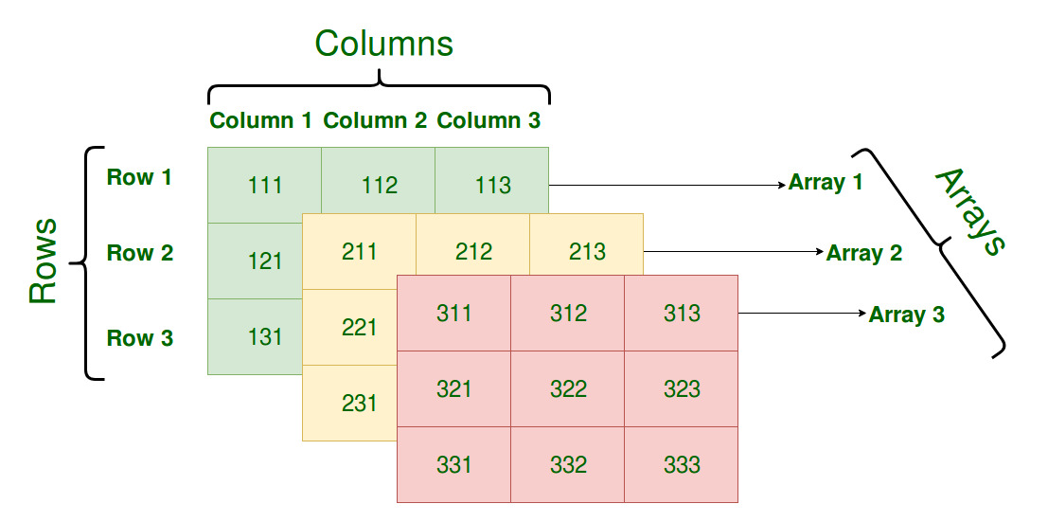
Representing a 3D array in a Tabular Format
A three – dimensional array can be seen as a tables of arrays with ‘x’ rows and ‘y’ columns where the row number ranges from 0 to (x-1) and column number ranges from 0 to (y-1).

Slide 32
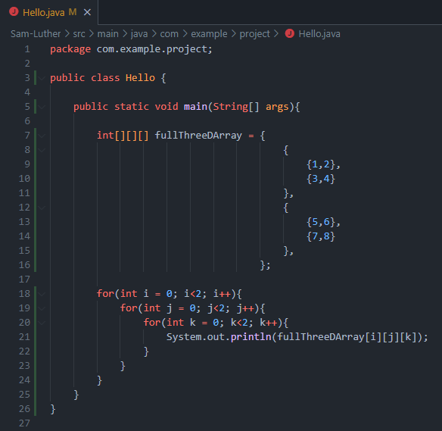
Print a 3D array in tabular format
To output all the elements of a Three-Dimensional array, use nested for loops.
For this three for loops are required, One to traverse the arrays, second to traverse the rows and another to traverse columns.

Slide 33
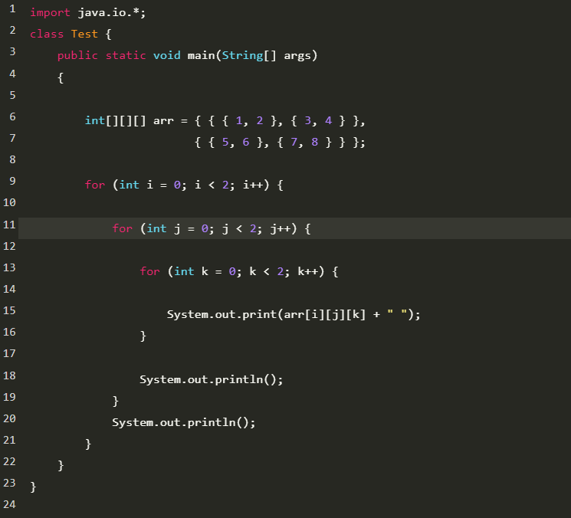
output:
1 2
3 4
5 6
7 8

Slide 34
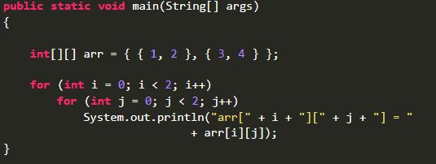
All Dimensions of Arrays
To iterate over a two dimensional array you need two nested loops like so:
Make sure you use a new identifier for the iteration int in each loop.

Slide 35
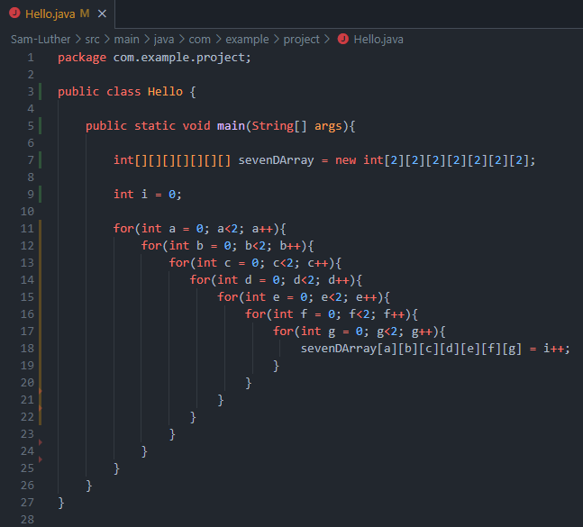
All Dimensions of Arrays
To iterate over a three-dimensional array, you need three nested loops, for a four-dimensional array four nested loops and so on.

Slide 36
All Dimensions of Arrays
To iterate over a three-dimensional array, you need three nested loops, for a four-dimensional array four nested loops and so on.
After the third dimension it begins to be a bit tricky to imagine where your data would be if you were to model it but the addresses are still easy. The first element of a 9th dimensional array would just be arr[0][0][0][0][0][0][0][0][0].

Slide 37
All Dimensions of Arrays
To iterate over a three-dimensional array, you need three nested loops, for a four-dimensional array four nested loops and so on.
After the third dimension it begins to be a bit tricky to imagine where your data would be if you were to model it but the addresses are still easy. The first element of a 9th dimensional array would just be arr[0][0][0][0][0][0][0][0][0].
Arrays in java have no dimensional limit in theory but in practice the compiler gives up at 255.

Slide 38
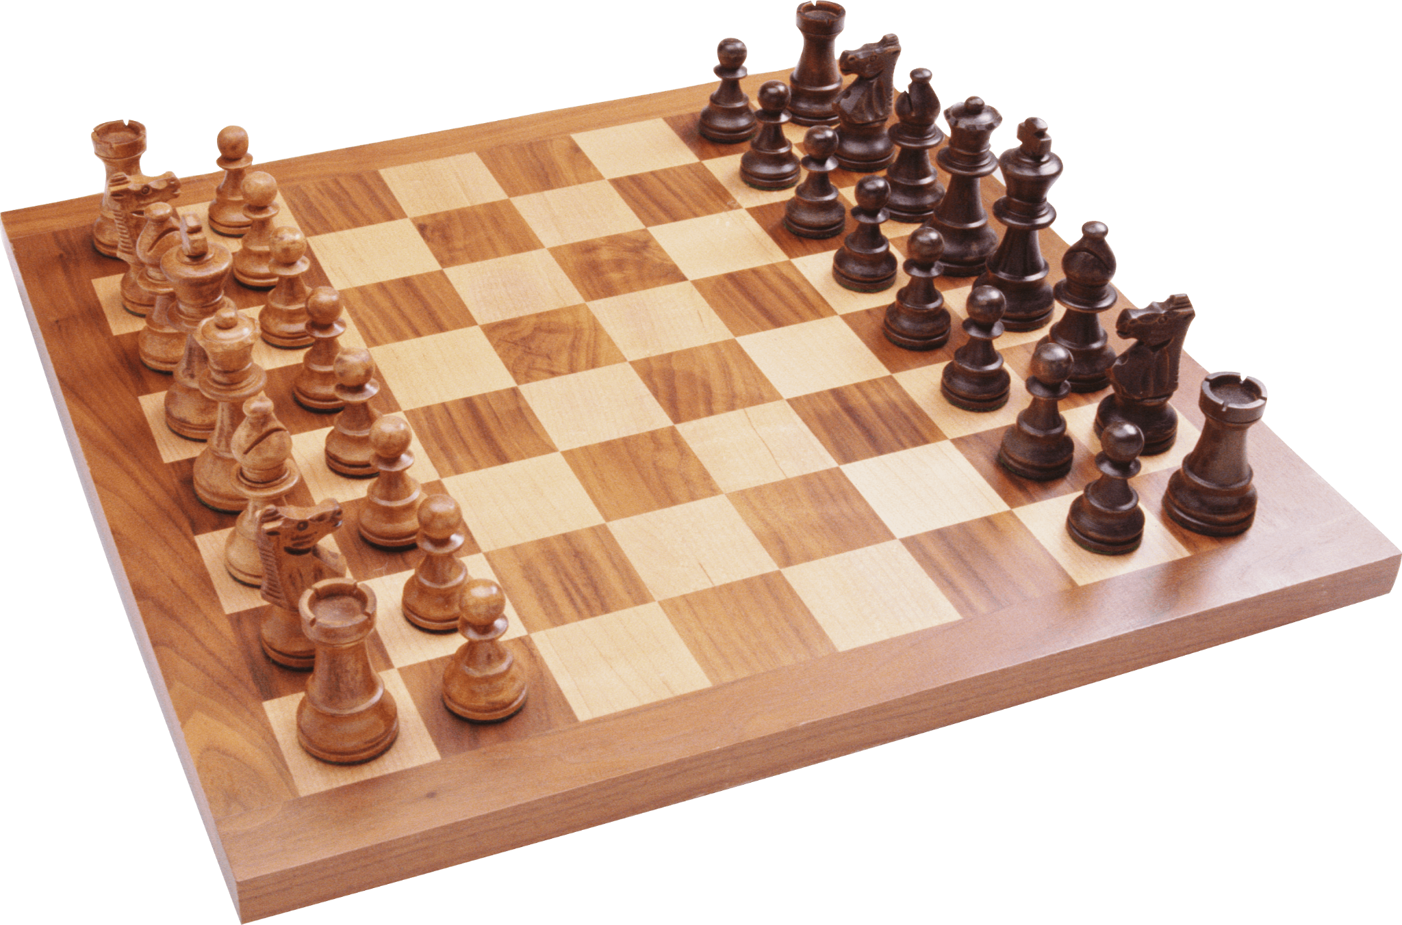
Chess Example
x-axis
y-axis
Unicode Pieces: ♖♘♗♔♕♗♘♖
♙♙♙♙♙♙♙♙
♟︎♟︎♟︎♟︎♟♟︎♟︎♟︎
♜♞♝♛♚♝♞♜
You may need to run:
chcp 65001
In your terminal if these characters don’t show up.
T
I
M
E

Slide 39

Let's hop in live share

Slide 40
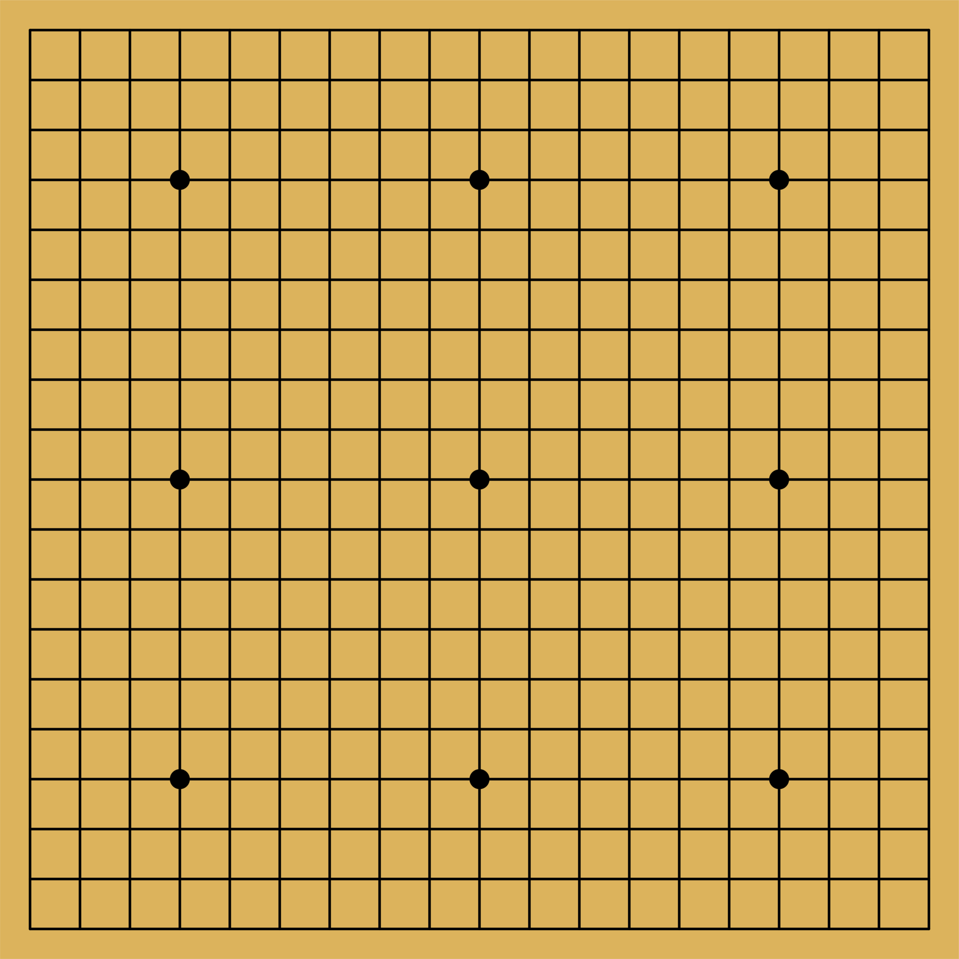
Your task
Navigate to your own project.
Create a two-dimensional array representation of a go board.
Place two go pieces, one black and one white, on the board.
Print out the board with its signature crosshatch pattern.

Slide 41
Closing
Please Read: 1.4 Arrays
Office Hours In SS-409:
Tu & Th 4:20pm – 5pm
Mon & Wed 1pm–4pm
TA Office Hours in the Fishbowl:
Mon & Wed 2pm–3pm
Have a great weekend and I’ll see you on Monday!

